Slide 1

MEDJACKET INDIA PVT. LTD
Health is my right
Your patients, our innovations
— a harmonious journey to well-being.

Slide 2

AGENDA
About Medjacket
Medjacket brochure
Medjacket Modules
Medjacket Pro
Medjacket advantages

Slide 3
About Medjacket
Best Medical Software Provider, Is Your Choice
Why Choose us
Mission & Vision
Established in 2021, MedJacket strives to enhance healthcare with cutting-edge equipment, adhering to the highest quality and industry standards. Our commitment to innovation empowers healthcare providers for optimal patient care, reflecting our relentless pursuit of excellence.
With over 3 years of experience under our hard hat, we partner with owners and design professionals to build high-quality projects. Over the years, Medjacket has built relationships with the industry’s top health professionals, and all of whom adhere to our high standards of quality.
Committed to revolutionizing patient care, Every Stakeholder expectations encompassing the whole medical arena. we set new standards in healthcare technology through relentless innovation. Our bedside monitors and software provide real-time, accurate data, empowering medical professionals for optimal patient safety and comfort.

Slide 4
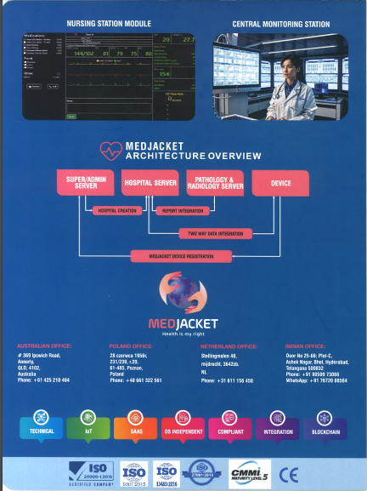
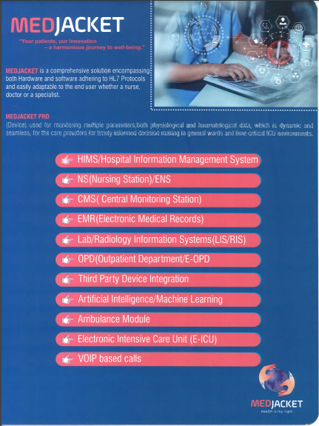
Medjacket Broucher:

Slide 5
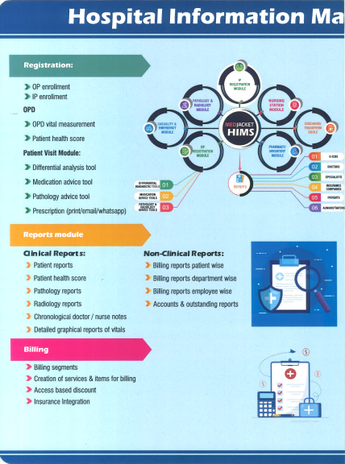
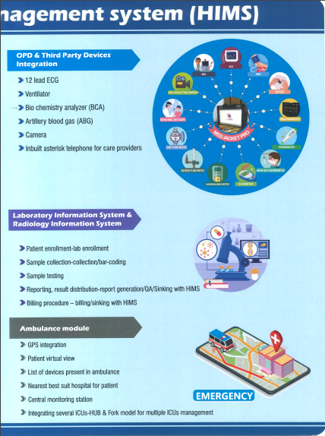

Slide 6
Medjacket HIMS Modules
Patient Registration
Third Party Integration
CMS
OPD
AI/ML
Nursing Station
IPD
Ambulance Module
LIS / RIS

Slide 7
E-ICU
HRM
Operation Theatre Module
VOIP Based Call
Laundry Management System
Tally Integration
Blood Bank
EMR
Bio-medical Waste Management
Camera Integration
Finance Module

Slide 8
Registration
Patient Registration
Clinical Reports
Smart card search
Billing
Patient visit Module
User Based Access
Patient Health Score
Ward Management
Non Clinical Reports
Room Management

Slide 9
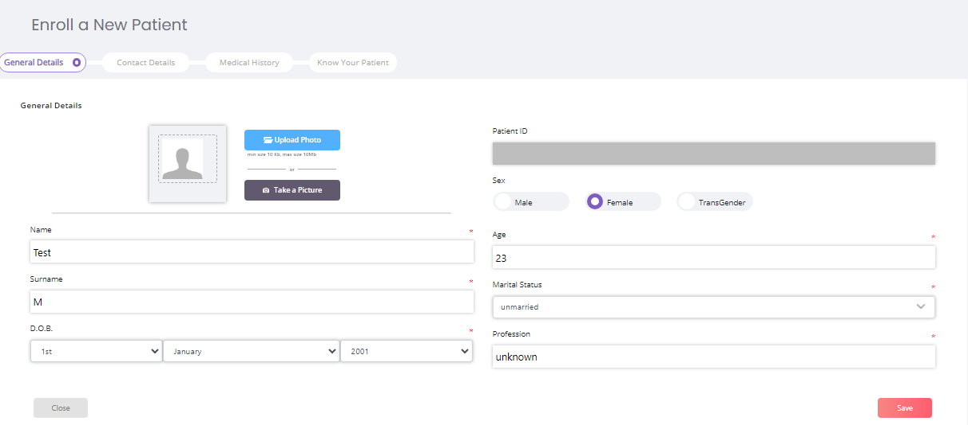
Patient Registration

Slide 10
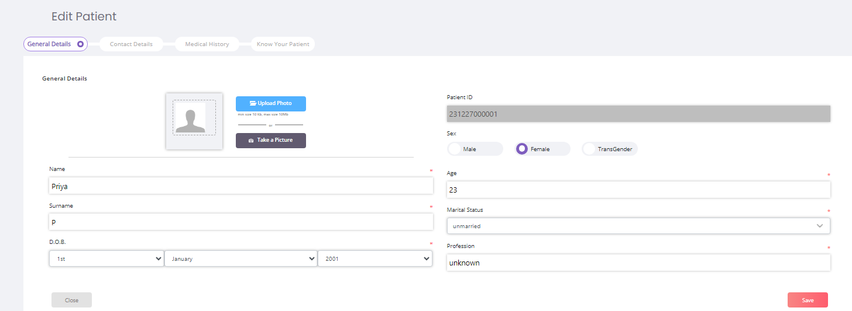
Modify Patient Details:

Slide 11
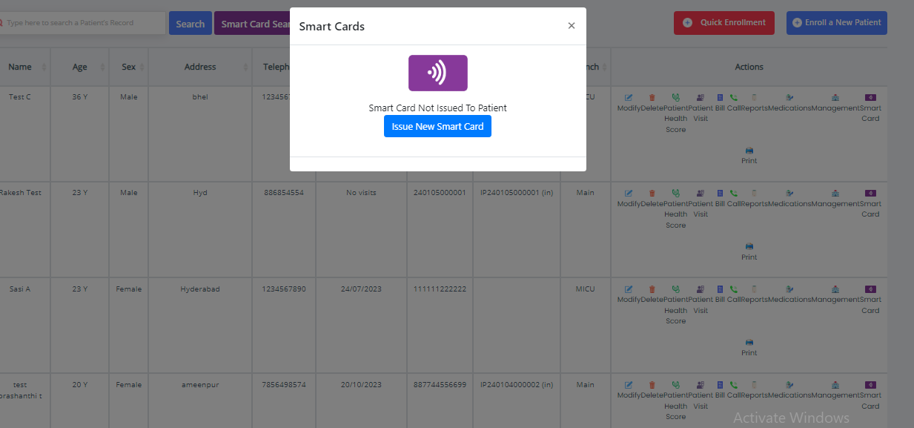
Smart Card search

Slide 12
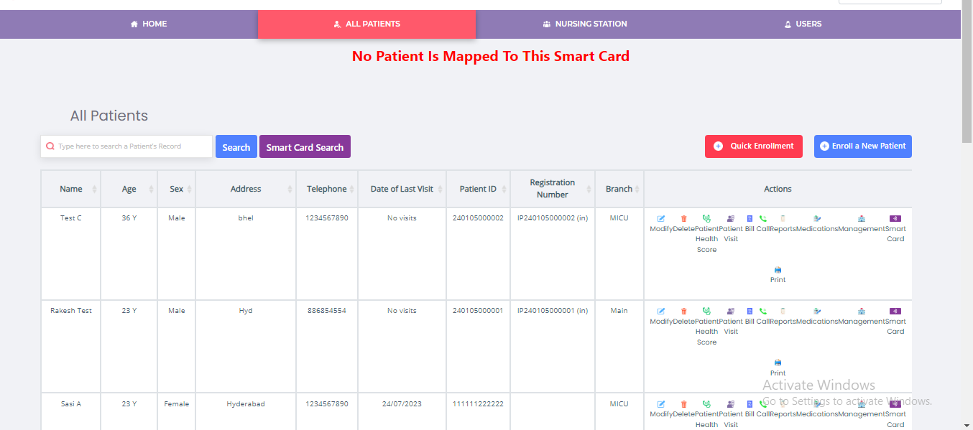
Smart Card Search

Slide 13
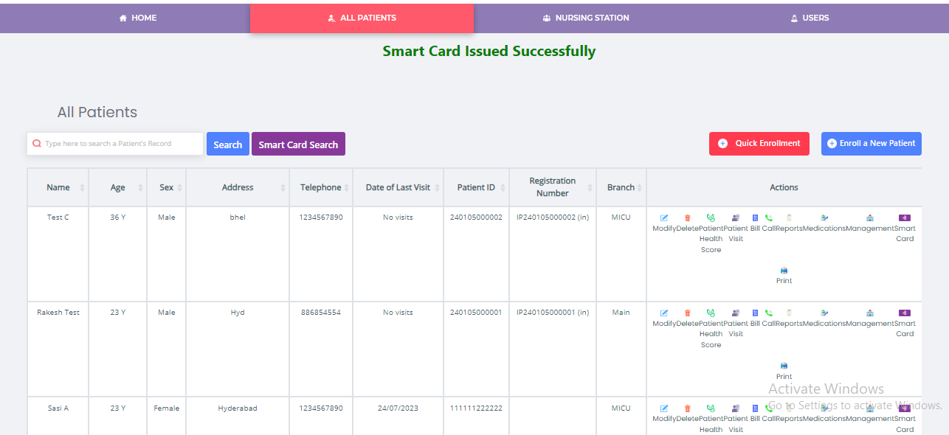
Issuing Smart Card:

Slide 14
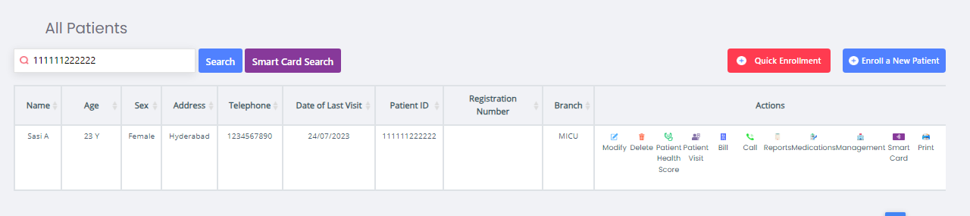
Smart search

Slide 15
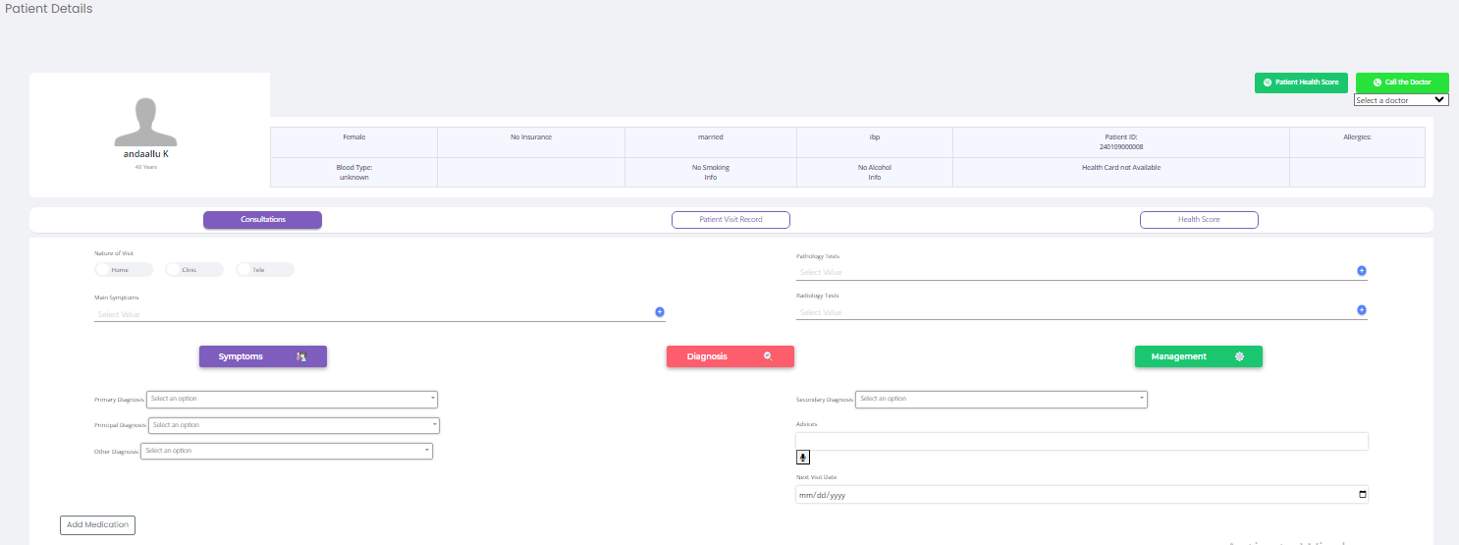
Patient Visit Module

Slide 16
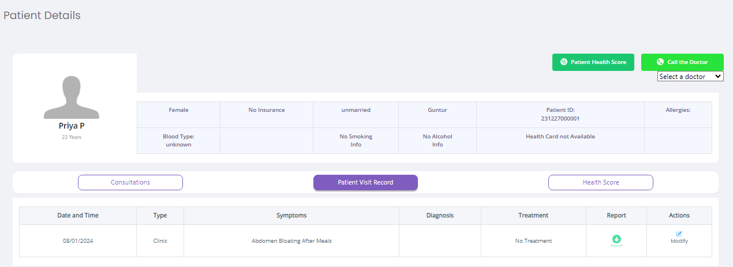
Patient Visit Record

Slide 17
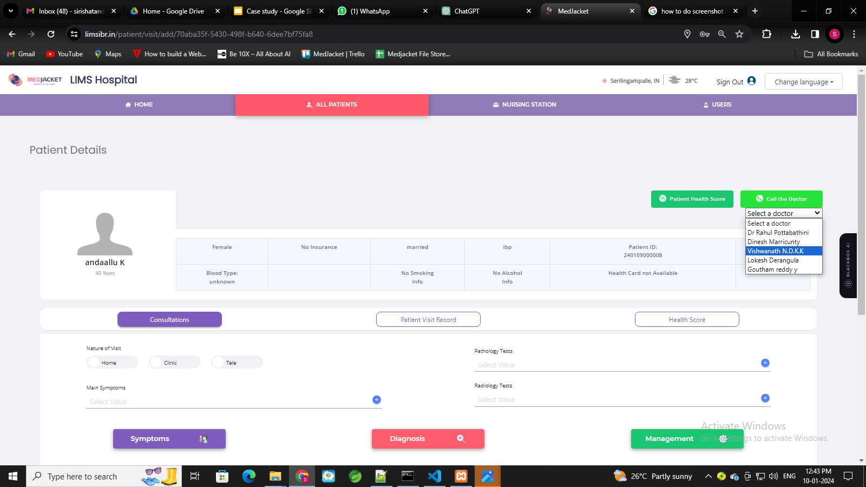
Selecting the Doctor for virtual connectivity:

Slide 18
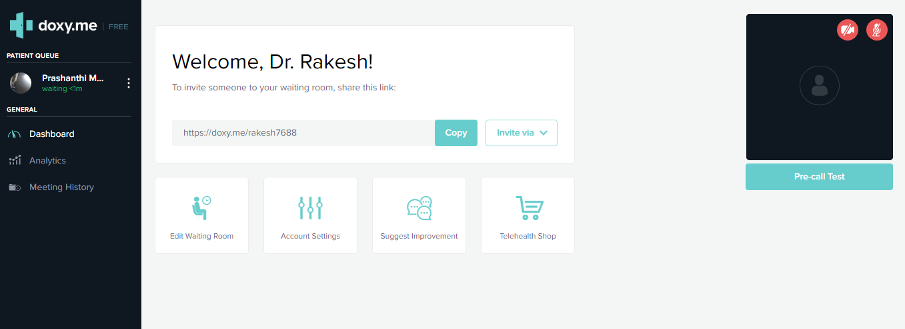
Doctor’s Waiting Room:

Slide 19
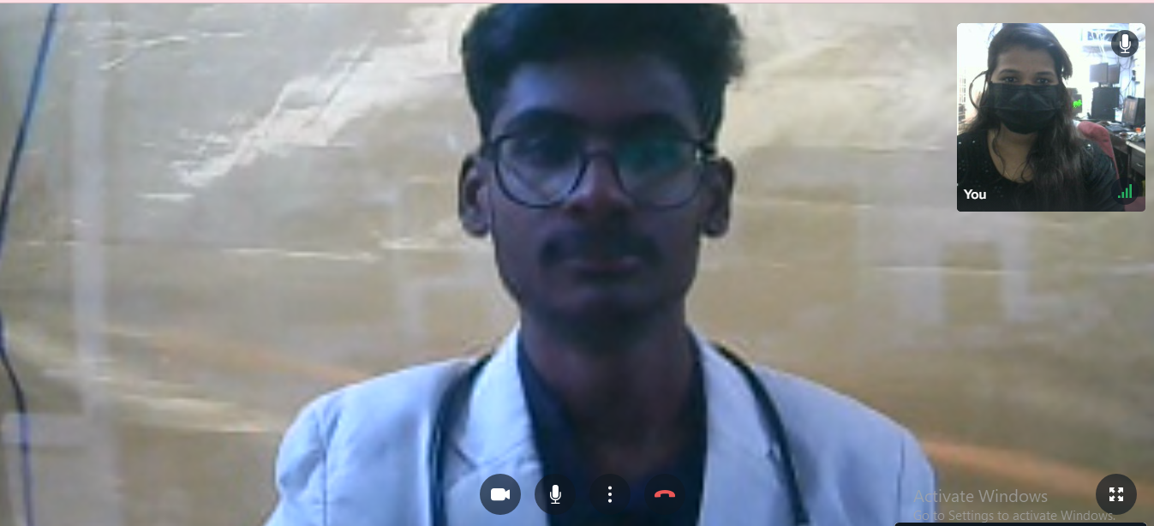
Virtual Patient Consultation:

Slide 20
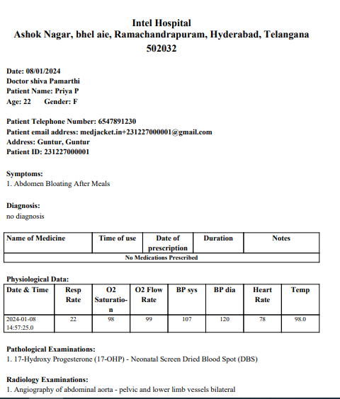
Patient Visit Report

Slide 21
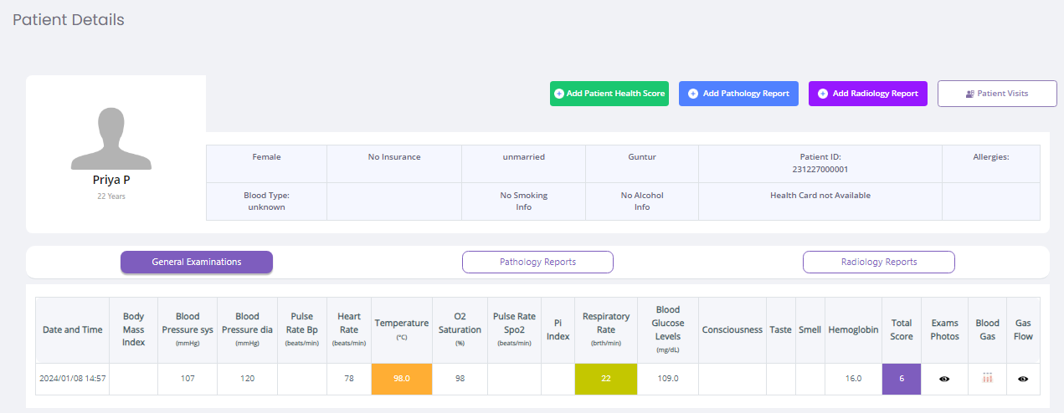
Patient Health score

Slide 22
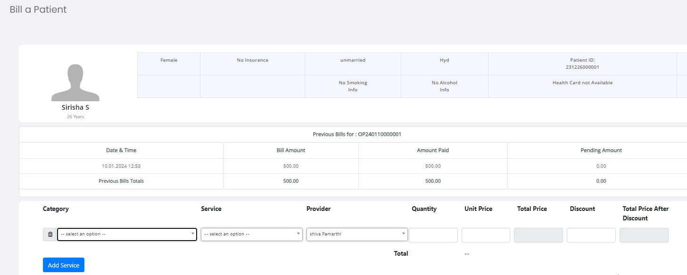
Bill a Patient:

Slide 23
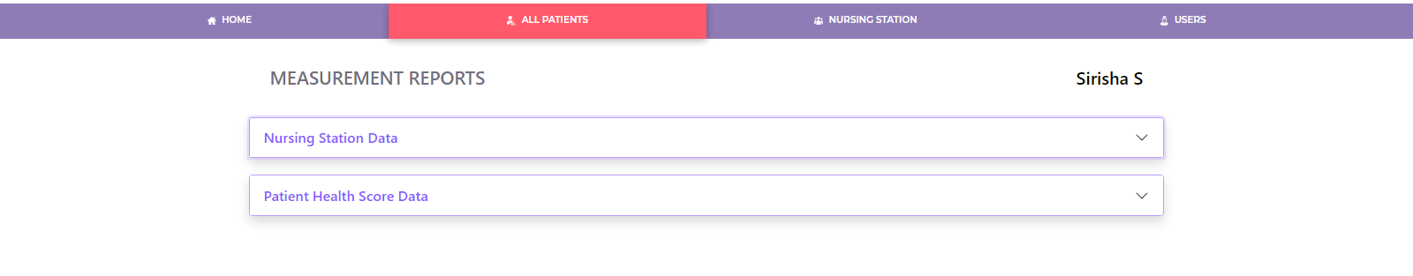
Reports of the patient:

Slide 24
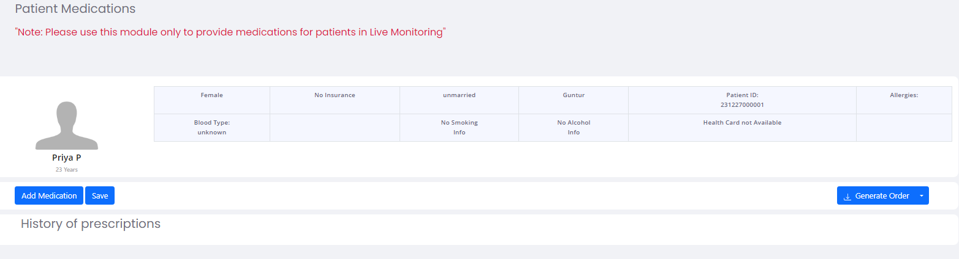
Patient Medications:

Slide 25
Non Clinical Reports
User wise Billing Summary
Doctor wise Consultations
Patient Registration Report
Investigations Summary Report
User wise Billing Details
Billing Summary
Patient Discharge Report
Billing Details

Slide 26
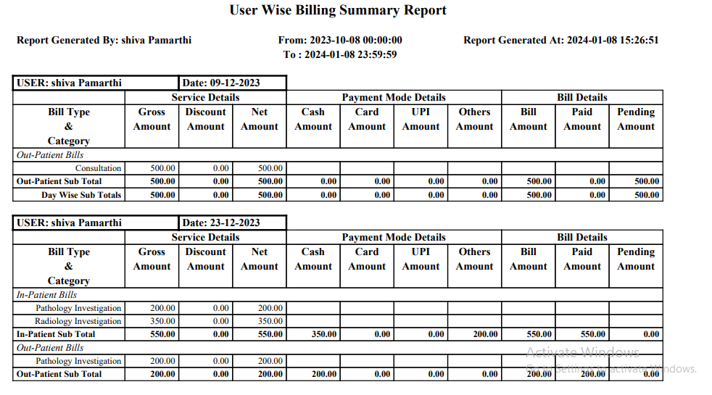
User wise Billing Summary

Slide 27
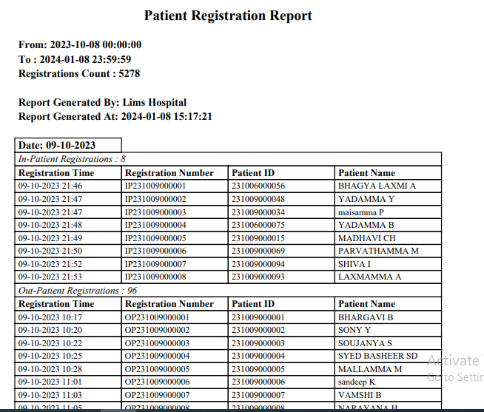
Patient Registration Report

Slide 28
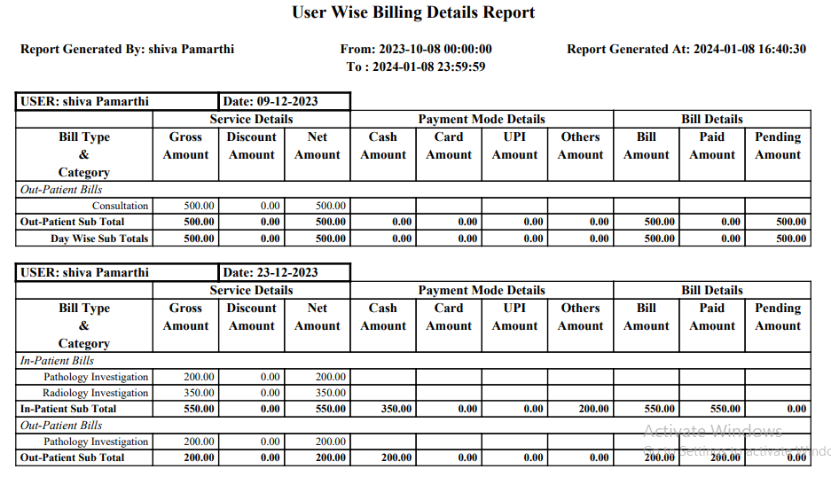
User wise Billing Details

Slide 29
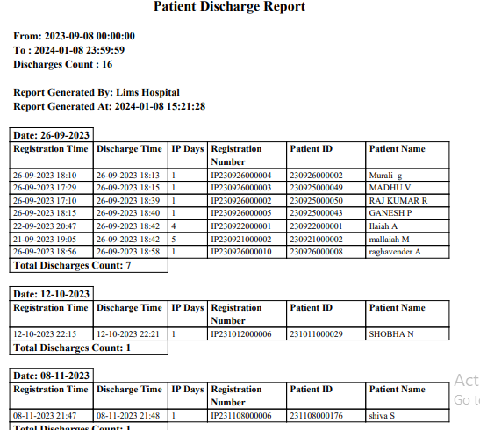
Patient Discharge Report

Slide 30
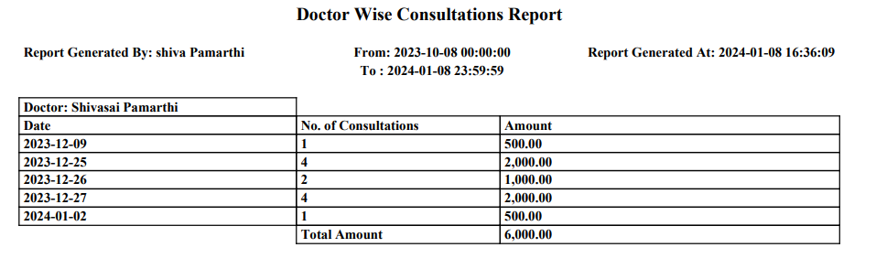
Doctor wise Consultations

Slide 31
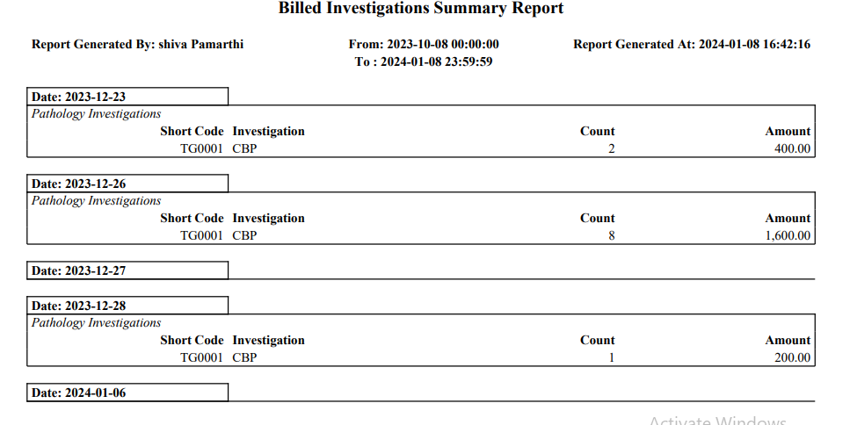
Investigations Summary Report

Slide 32

Clinical Reports
Patient Reports
Patient Health Score
Pathology Reports
Radiology Reports
Nursing Station Data

Slide 33
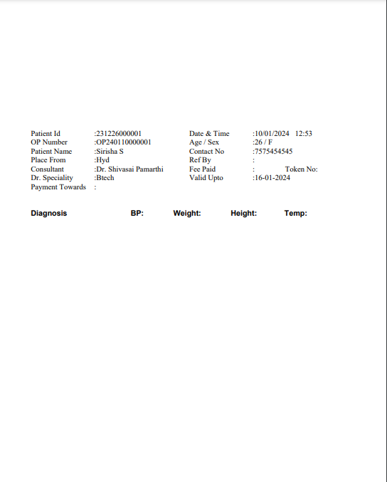
OP Card:

Slide 34
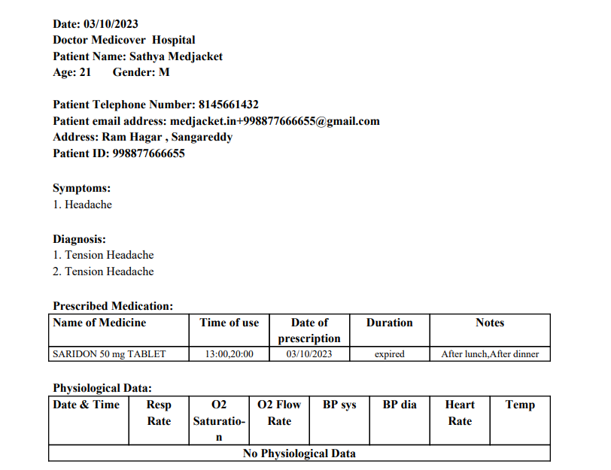
Patient Reports

Slide 35
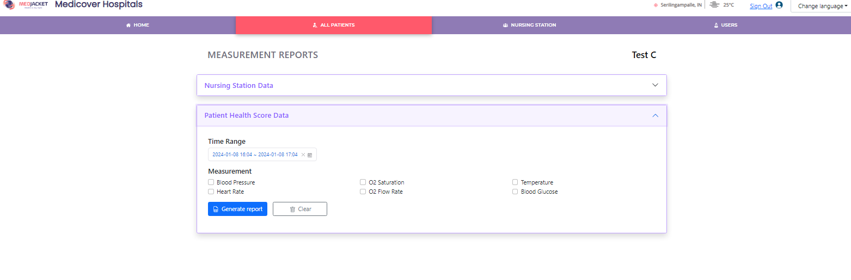
Patient Health Score Report

Slide 36
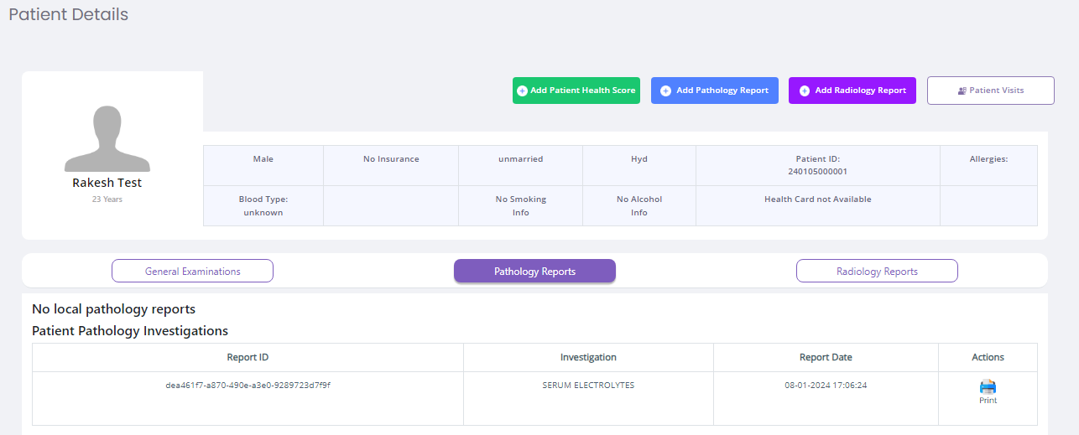
Pathology Reports

Slide 37
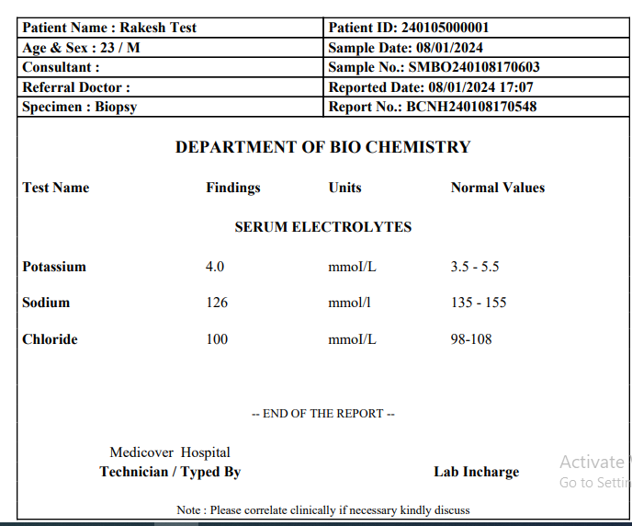

Slide 38
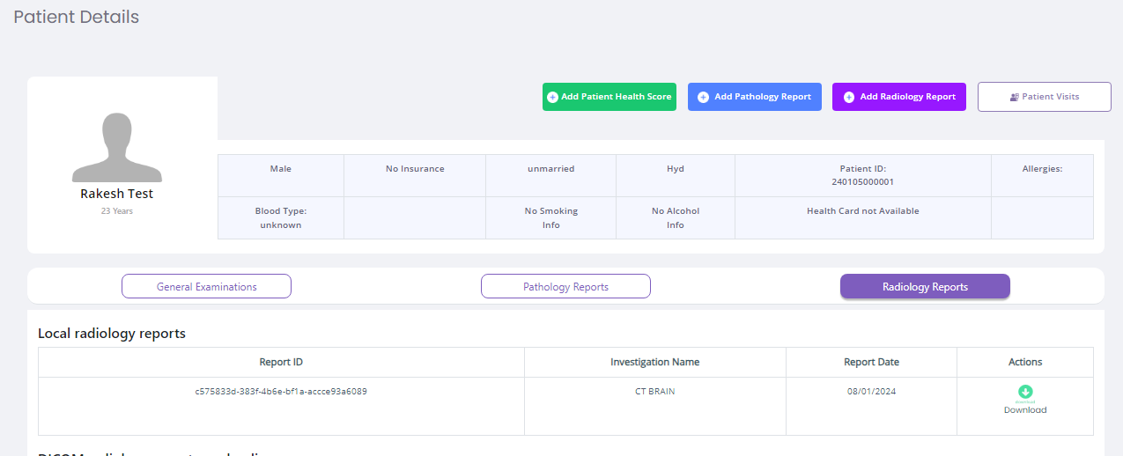
Radiology Reports

Slide 39
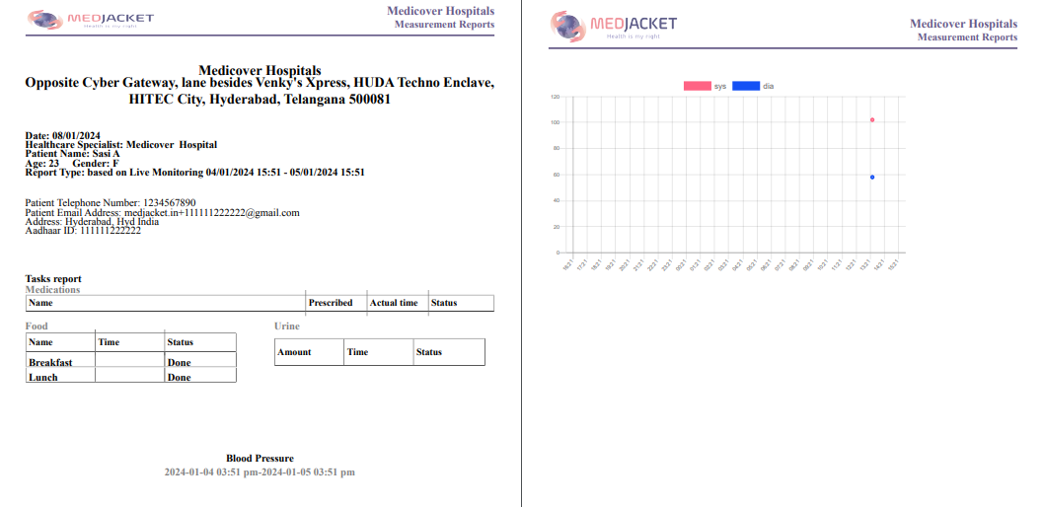
Nursing Station Data

Slide 40
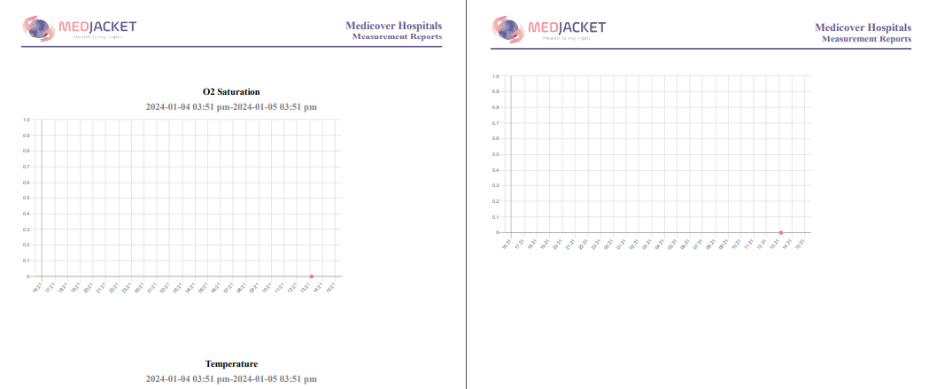

Slide 41
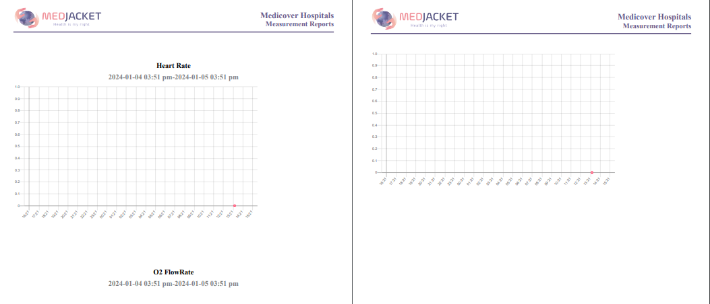

Slide 42
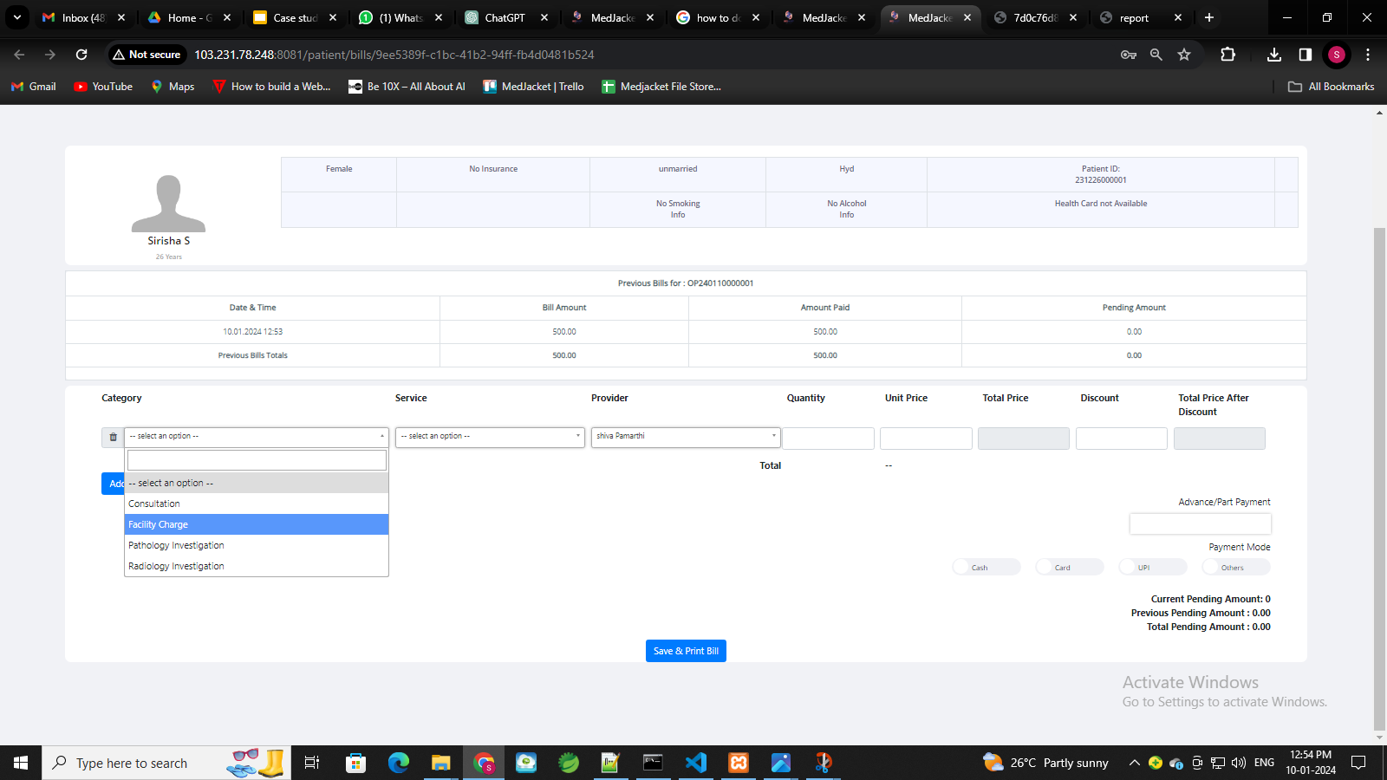
Billing
Creation of Services and Item for Billing:

Slide 43
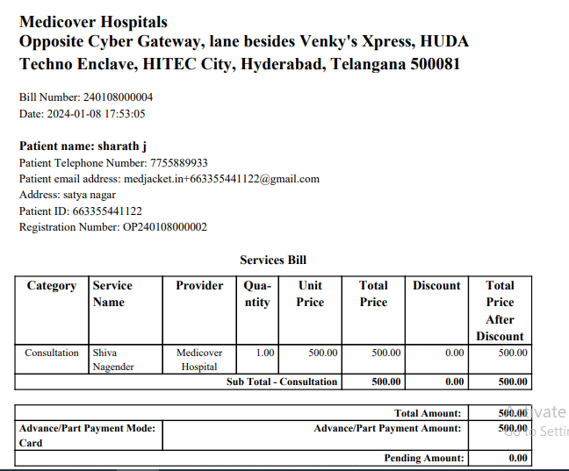
Bill Receipt

Slide 44
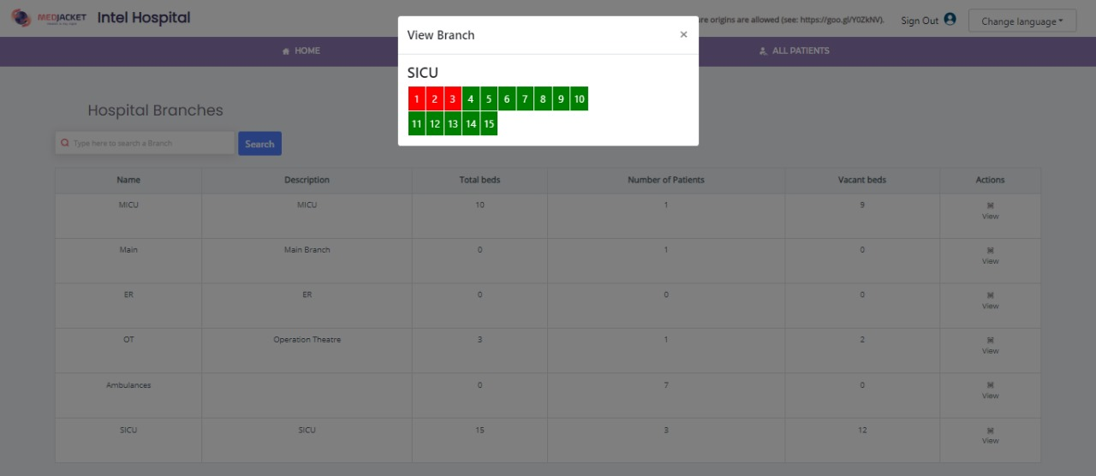
Bed Management

Slide 45
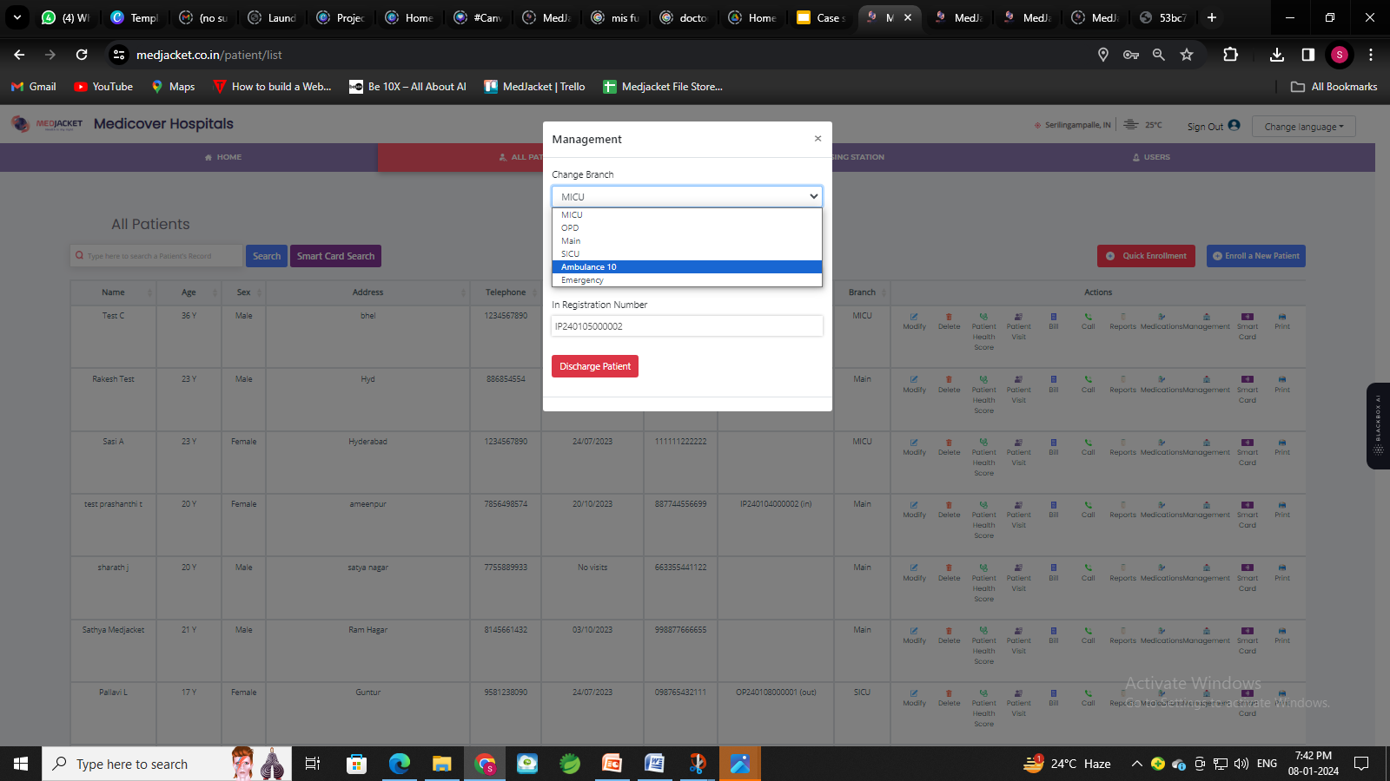
Ward Management:

Slide 46
User Based Access
Admin Login
Pathologist Login
Doctor Login
Radiologist Login
Nurse Login
Receptionist Login

Slide 47
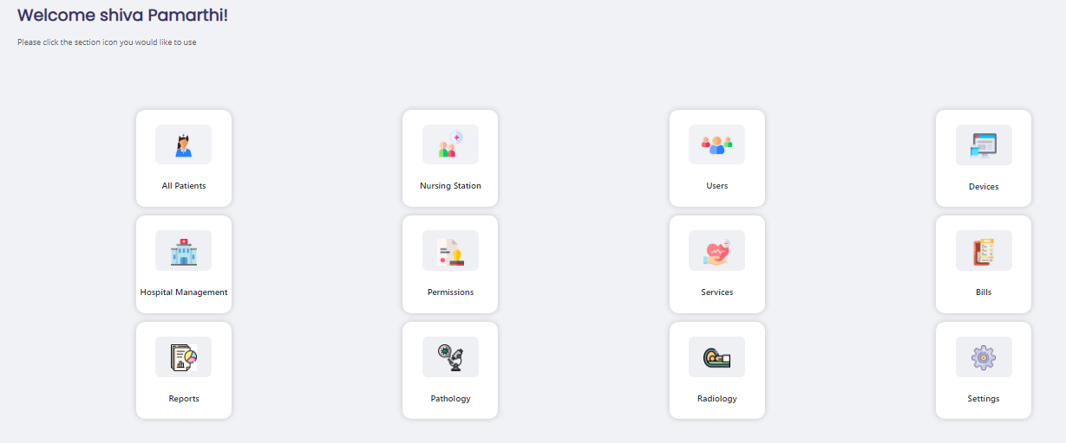
Admin Dashboard:

Slide 48
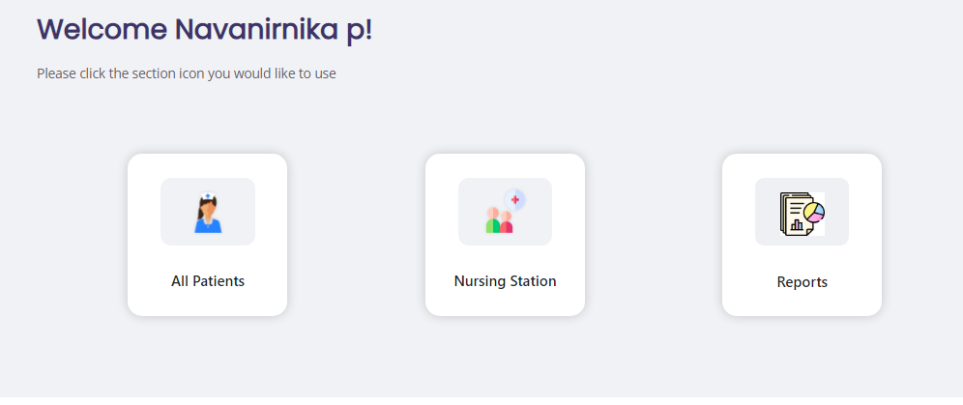
Doctor Dashboard:

Slide 49
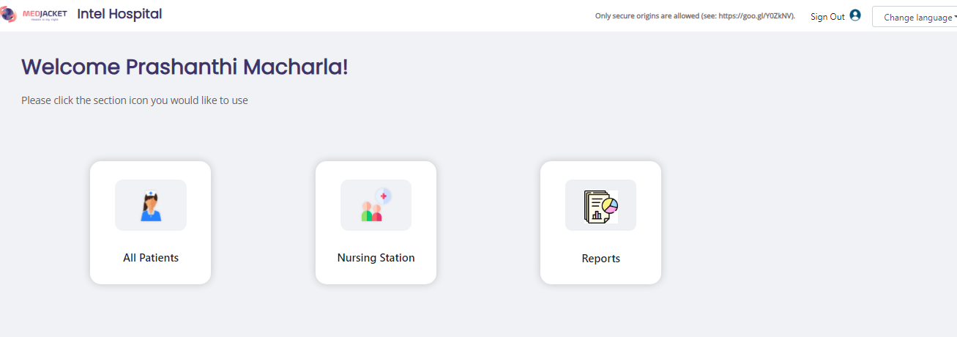
Nurse Login:

Slide 50
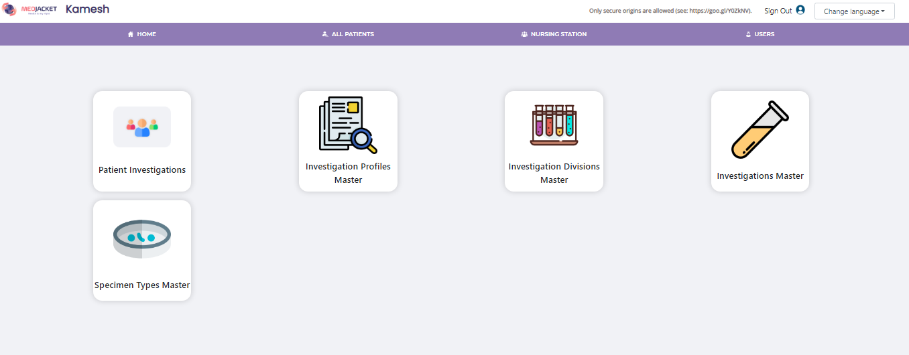
Pathologist Dashboard:

Slide 51
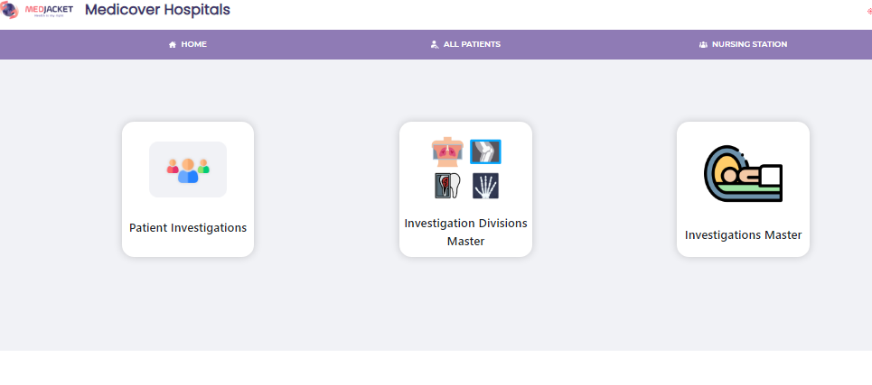
Radiologist Dashboard:

Slide 52
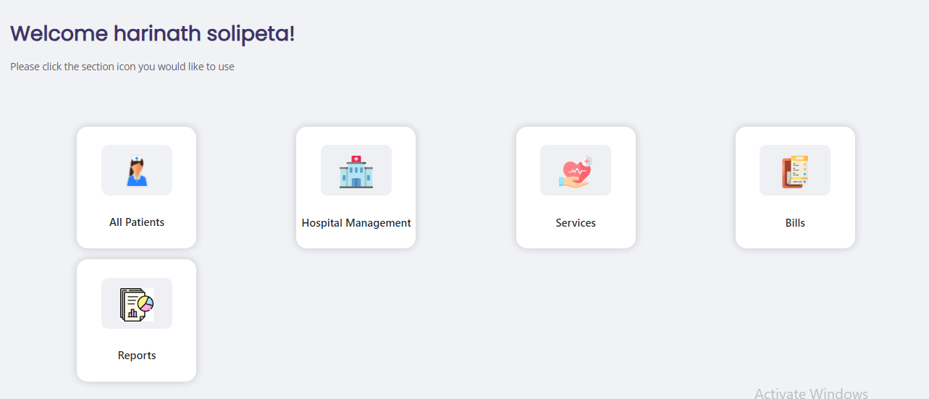
Receptionist Dashboard:

Slide 53
OPD
Introducing MedJacket OPD: Rapid, Comprehensive Care
In today's fast-paced healthcare environment, every minute counts. That's why we've developed MedJacket OPD, a cutting-edge solution designed to streamline outpatient department visits. In just five minutes, our system provides a comprehensive view of vital health metrics, ensuring efficient and precise care delivery.
Enhanced Efficiency
Patient-Centered Care
Swift Data Integration
Data Security
OPD
Real-time Monitoring
Customized Reporting

Slide 54
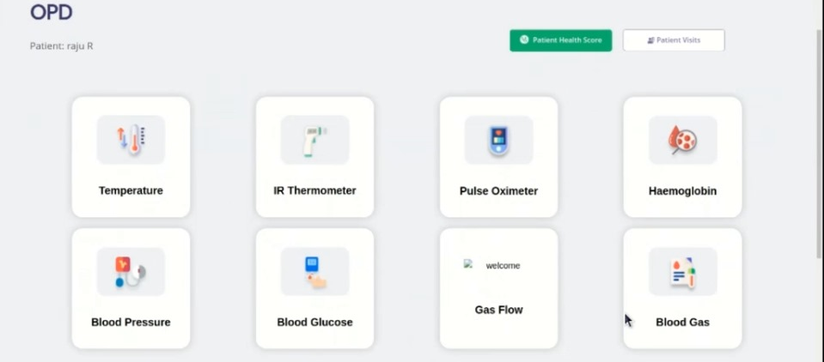
MedJacket OPD:

Slide 55
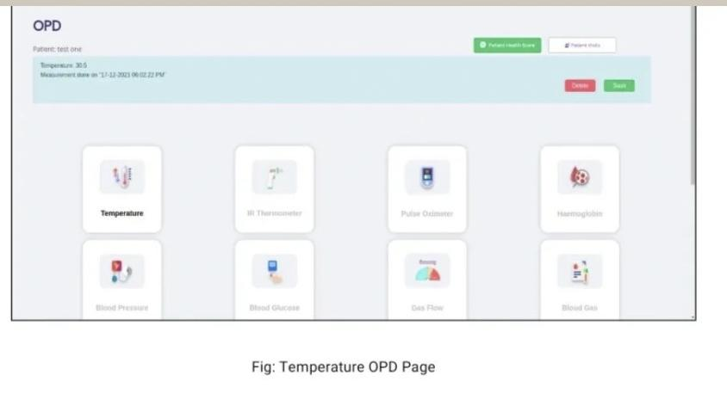
Patient Vitals in medjacket pro:

Slide 56
IPD
Bed Occupation Matrix
Admission and Bed Allocation
Payment Receipts
Medical Observation and Nursing Notes
Operation /Delivery Details
In Patient Report
Medical Certificates
Patient Dues Report
Nursing Station Status
Discharge Summary & Details

Slide 57
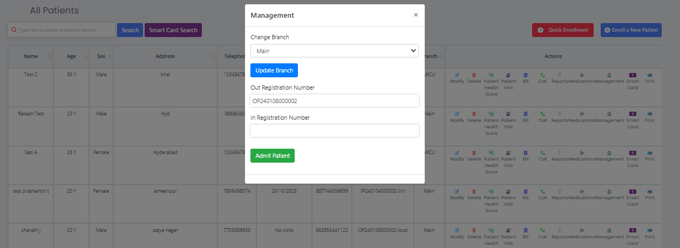
IP Management:

Slide 58
Ward Management:

Slide 59
Cloud Central Monitoring Station
Benefits of Central Monitoring Station with Hub & Fork Model:
Centralized Oversight:
The Hub & Fork model centralizes the monitoring and management of multiple ICUs, ensuring consistent and standardized care protocols.
Remote Accessibility:
Healthcare professionals can access patient data and make informed decisions from any location with an internet connection, enabling timely interventions and reducing response times.
Improved Patient Outcomes:
Real-time monitoring and medication management lead to more precise and effective care, potentially reducing complications and improving patient outcomes.

Slide 60
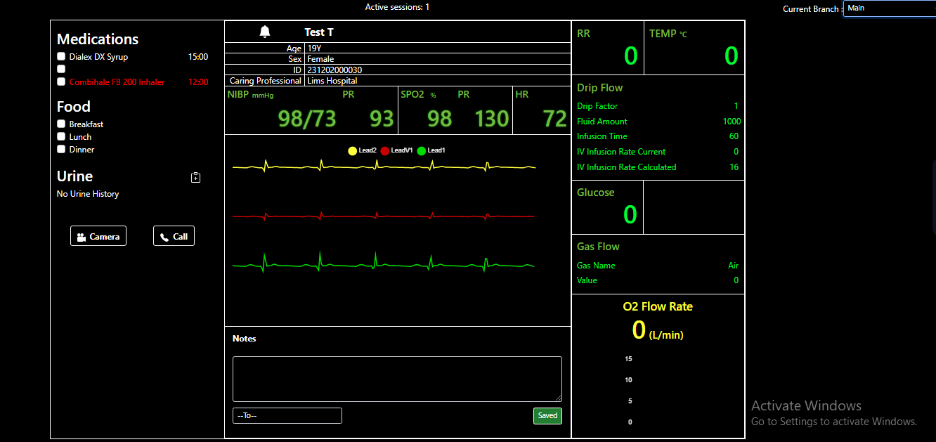
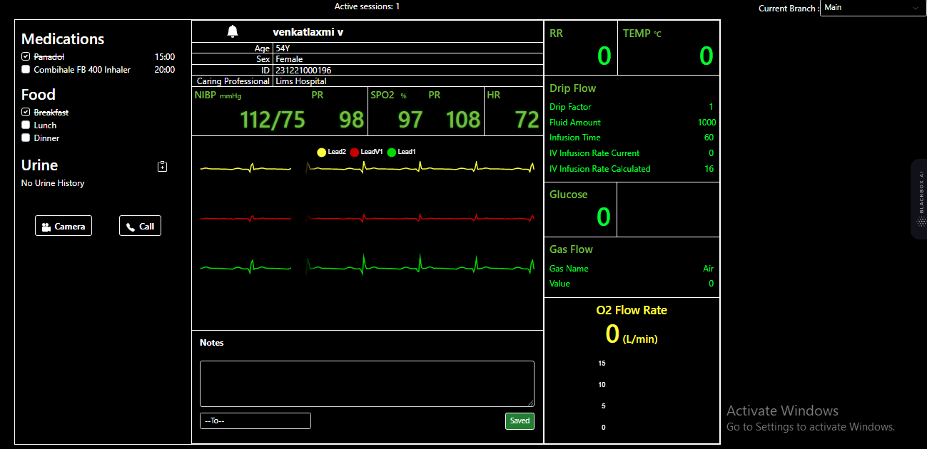


Central Monitoring Station:
RICU
SICU
CICU
NICU

Slide 61
NURSING STATION
Real-Time Monitoring, Anywhere in the World
Multi-Parameter Module for Comprehensive Care
A New Horizon in Critical Care
Nursing Station
Seamless Communication for Enhanced Patient Care
Prescription and Medication Management

Slide 62
Multi-Parameter Module for Comprehensive Care:
The MedJacket Pro Nursing Station combines a multitude of critical parameters into one unified interface, ensuring nothing goes unnoticed. From ECG with 5-lead and 3 channels, NIBP, SPO2, and temperature readings (both contact and Infrared) to specialized meters like the Glucometer, Hemoglobin meter, Drip flow meter, Oxygen flow meter, and Capnography, all vital signs are at your fingertips.
Real-Time Monitoring, Anywhere in the World:
With MedJacket Pro, healthcare providers have the freedom to monitor patients from virtually anywhere on the globe. Our platform provides a secure connection to ICU devices, allowing doctors to stay informed about patient status, regardless of their physical location.
Seamless Communication for Enhanced Patient Care:
The MedJacket Pro Nursing Station not only provides data but also facilitates communication. Doctors can offer real-time notes and recommendations to nurses, ensuring that patient care is tailored and responsive to their evolving needs. This direct line of communication fosters a collaborative care environment.

Slide 63
Prescription and Medication Management:
MedJacket Pro goes beyond monitoring; it enables doctors to prescribe medications directly through the platform. This feature ensures that treatment plans are promptly executed, enhancing patient outcomes and streamlining the care process.
A New Horizon in Critical Care:
MedJacket Pro Nursing Station represents a milestone in critical care monitoring. By providing a unified platform for real-time data and communication, we're redefining how healthcare professionals provide top-notch care to patients in need.

Slide 64

MedJacket Pro Nursing Station:
At MedJacket, we're redefining critical care with the MedJacket Pro Nursing Station. This state-of-the-art platform seamlessly integrates a comprehensive array of ICU devices, providing healthcare professionals with a unified view for precise patient monitoring.

Slide 65

Medication for IP Patient:

Slide 66
Nursing Station:

Slide 67
LIMS
The MedJacket application incorporates a robust Laboratory Information Management System (LIMS) to streamline the process of uploading, managing, and accessing patient pathology reports.
Integration with MedJacket Health Score
Compliance and Quality Assurance
LIMS
Alerts and Notifications
Seamless Data Management

Slide 68
Seamless Data Management:
MedJacket's LIMS module provides laboratories with a sophisticated platform to efficiently manage patient pathology reports. It allows for easy data entry, tracking, and retrieval of lab test results.
Integration with MedJacket Health Score:
Laboratories can securely upload patient pathology reports directly to the patient's Health Score within the MedJacket application. This ensures that the data is readily available to the patient and their healthcare team for ongoing monitoring and treatment planning.
Compliance and Quality Assurance:
The LIMS in MedJacket complies with industry standards and regulations to ensure the accuracy, integrity, and confidentiality of patient data. It also facilitates quality control processes within the laboratory.
Alerts and Notifications:
The system can generate alerts for critical results or abnormal findings, ensuring that healthcare providers are promptly informed of any urgent medical issues.

Slide 69
Pathologist Dashboard:

Slide 70

Sample Collection:

Slide 71

Collect Sample:

Slide 72

Result Form:

Slide 73

Test Report:

Slide 74

Reflecting in Patient Health score:

Slide 75
RIMS
The MedJacket application incorporates a robust Radiology Information Management System (RIMS) to streamline the process of uploading, managing, and accessing patient Radiology reports.
Efficient Imaging Workflow
Image Archiving and Retrieval
RIMS
Integration with Health Score
Advanced Imaging Analytics

Slide 76
Efficient Imaging Workflow:
MedJacket's RIS module streamlines the process of capturing, storing, and managing radiology reports and images. It optimizes the workflow for radiologists and imaging departments.
Integration with Health Score:
Radiology reports, including images, can be securely uploaded to the patient's Health Score within the MedJacket application. This integration ensures that both patients and healthcare providers have immediate access to critical imaging information.
Advanced Imaging Analytics:
The RIS provides tools for radiologists to analyze and interpret images, allowing for accurate diagnoses and treatment planning.
Image Archiving and Retrieval:
The system offers a comprehensive archive of radiology images and reports, facilitating easy retrieval for future reference and comparison.

Slide 77
Radiologist Dashboard:

Slide 78

Status of Action:

Slide 79

Uploading the test result:

Slide 80

Reflecting in Patient Health score:

Slide 81
Third Party Device Integration
MedJacket's third-party device integration opens a world of possibilities for healthcare providers. It allows for the seamless incorporation of a wide range of external medical devices, expanding the scope of patient monitoring and diagnostics.
Glucometer
Bio chemistry analyzer
Fetal Monitor
Haemoglobin
Arterial Blood Gas
X-Ray
Temperature Probes
Ventilator
Spirometer
Blood Pressure
12 Lead ECG
IR Gun
Pulse Oximeter
5-Lead ECG
Multi parameter Monitor

Slide 82








Glucometer
Haemoglobin
Temperature Probes
BP Cuff
Pulse Oximeter
Bio Chemistry Analyzer
Arterial Blood Gas
Ventilator

Slide 83







12 Lead ECG
5 Lead ECG
Fetal Monitor
Otoscope
Spirometer
IR Gun
Multi parameter monitor

Slide 84
Artificial Intelligence
Medication advice tool:
Gone are the days of sifting through extensive medication lists. With MedJacket, input the diagnosis and witness the device's intelligent algorithm generate tailored medication suggestions. This not only expedites decision-making but ensures that patients receive the most suitable treatment promptly.
Pathology advice tool:
MedJacket sets a new standard in convenience and efficiency. All essential pathology tests are meticulously predefined within the device. This means that healthcare providers have immediate access to a comprehensive list of tests, eliminating the need for manual searches or referrals.
Prescription:
In our mission to redefine healthcare technology, MedJacket introduces a groundbreaking feature that enhances patient communication and convenience. Our advanced software allows healthcare providers to effortlessly send prescriptions and health reports directly to patients, offering multiple options for delivery.With MedJacket, providing patients with their prescriptions and health reports has never been easier.

Slide 85


Slide 86


Slide 87
Ambulance Module
Patient Virtual View
GPS Integration
Ambulance Module
List of Devices Present in Ambulance
Hospitalization

Slide 88
GPS Integration:
The module incorporates GPS technology, allowing for real-time tracking of the ambulance's location. Dispatchers and medical teams can monitor the precise position of the ambulance throughout its journey. This feature enables efficient navigation and helps in providing accurate arrival time estimates to the patient's location.
Patient Virtual View:
The module includes a camera integration system within the ambulance, providing a live visual feed of the patient's condition to the medical team. This allows for immediate assessment and triage, enabling healthcare providers to prepare and allocate appropriate resources before arriving at the scene.
List of Devices Present in Ambulance:
The module maintains a comprehensive inventory of all medical devices and equipment available in the ambulance. This feature ensures that the medical team is aware of the resources at their disposal, helping them make informed decisions about patient care.

Slide 89
Nearest Best Suit Hospital Recommendation:
Utilizing advanced algorithms and real-time data, the module analyzes the patient's condition and recommends the nearest and most suitable hospital for their specific needs. Factors such as the hospital's specialty, available resources, and current patient load are taken into account to make this determination.
Benefits of the Ambulance Module:
Improved Response Times
Enhanced Patient Care
Optimized Resource Allocation
Critical Decision Support
Data-Driven Efficiency

Slide 90
E-ICU
E-ICU Facility with MedJacket Device: Transforming Remote Patient Monitoring
The E-ICU facility provided by the MedJacket device represents a cutting-edge advancement in healthcare technology. It offers a solution for both small-scale clinics with limited onsite resources and affluent individuals seeking personalized home care. This technology enables healthcare providers to remotely monitor patient vitals, ensuring timely intervention and care. Here's a detailed overview of the E-ICU facility's functionalities and benefits:
Remote Patient Monitoring for Small-Scale Clinics
Timely Intervention and Consultation
Personalized Home Care for Affluent Individuals
Continuous Health Monitoring
Advanced Alerting System
Customized Care Plans

Slide 91


VOIP Based Call
Medjacket software utilizes Asterisk server technology for VoIP-based calls, ensuring reliable and efficient communication.
The VoIP infrastructure in Medjacket Software leverages Asterisk servers to enable seamless audio interactions, optimizing the user experience.
Asterisk-based VoIP calls within Medjacket software deliver a robust platform for telecommunication, supporting diverse functionalities for enhanced connectivity.

Slide 92
EMR
Electronic Medical Record (EMR) Feature in MedJacket Application:
The Electronic Medical Record (EMR) feature in the MedJacket application revolutionizes the way patient information is managed and shared. It offers a comprehensive and secure platform for healthcare providers to digitally store, access, and transmit patient medical history. Here's an in-depth look at the key functionalities and benefits of the EMR feature in MedJacket:
Digitalized Patient History
Efficient Information Retrieval
Accessibility Anytime, Anywhere
Secure Data Transmission
Integration with Health Score
Customizable Templates
The Electronic Medical Record feature in the MedJacket application represents a significant advancement in healthcare technology. It empowers healthcare providers with a powerful tool to manage patient information effectively and securely, ultimately leading to better patient care and outcomes.

Slide 93
Camera Integration
Camera Module Integration in MedJacket Device for Ambulances
The integration of a camera module in the MedJacket device designed for ambulances is a significant advancement in emergency medical technology. This feature provides critical visual information to healthcare providers, enabling them to assess and respond to the patient's condition and monitor the ambulance environment. Here's a detailed overview of the camera module functionalities and benefits:
Patient Condition Assessment
Real-Time Monitoring
Enhanced Communication
Ambulance Environment Monitoring
Incident Documentation
Support for Remote Consultations

Slide 94

Tally Integration
Login Page:

Slide 95

Importing Page:

Slide 96

Sale Bill:

Slide 97

Receipt:

Slide 98

Outstanding Consolidated:

Slide 99

Outstanding Expanded:

Slide 100

Category Wise Revenue Consolidated:

Slide 101

Consultation Expanded:

Slide 102

Pathology Expanded:

Slide 103

Radiology Expanded:

Slide 104

Services Expanded:

Slide 105

Bio-Medical Waste management

Slide 106

Add User:

Slide 107

Users List:

Slide 108

Add Category:

Slide 109

View Category:

Slide 110

Add Department:

Slide 111

View Department:

Slide 112

Add Waste Collection:

Slide 113

View Waste collection:

Slide 114

Types of Reports:

Slide 115

Waste generation log:

Slide 116

Waste generation log list:

Slide 117

Add Waste Transportation log:

Slide 118

View Waste Transportation log:

Slide 119

Add Training Session

Slide 120

View Training Session:

Slide 121

Add Annual Report:

Slide 122

View Annual Report:

Slide 123

Add Annual Biomedical Report

Slide 124

Human Resource Management
Login Page:

Slide 125

Dashboard:

Slide 126

Add Department:

Slide 127

Designation list:

Slide 128

Employee List:

Slide 129

Add new employee:

Slide 130

Employee list Pdf:

Slide 131

Employee list Excel:

Slide 132

Disciplinary action list:

Slide 133

Add Disciplinary Notice:

Slide 134

Inactive User:

Slide 135

Attendance list:

Slide 136

Add Attendance:

Slide 137

Add Bulk Attendance:

Slide 138

Attendance Report:

Slide 139

Holiday List:

Slide 140

Add Holiday:

Slide 141

Leave types:

Slide 142

Add leave Types:

Slide 143

Leave Application List:

Slide 144

Add Leave Application:

Slide 145

Earn Leave:

Slide 146

Assign Earned Leave:

Slide 147

Leave Report List:

Slide 148

Project List:

Slide 149

Add Project List:

Slide 150

Task List:

Slide 151

Payroll List:

Slide 152

Payroll View:

Slide 153

Types of salary:

Slide 154

Add salary types:

Slide 155

Grant Loan:

Slide 156

Add Loan:

Slide 157

Loan Installments:

Slide 158

Assets Category List:

Slide 159

Add Assets Category:

Slide 160

Assets List:

Slide 161

Logistic Support:

Slide 162

Notice Board:

Slide 163

Add Notice:

Slide 164

Laundry Management

Slide 165

Dashboard:

Slide 166

Departments Data:

Slide 167

Department Data Input:

Slide 168

Department Transaction:

Slide 169

Categories List:

Slide 170

Products Data:

Slide 171

Products data input:

Slide 172

Lenin Store Data:

Slide 173

Purchase Data:

Slide 174

Purchases:

Slide 175

Suppliers data:

Slide 176

Quantity of Items in particular department:

Slide 177


Slide 178

Transactions:

Slide 179


Slide 180


Slide 181

Blood Bank
Dashboard:

Slide 182

Donor Details:

Slide 183

Patient Details:

Slide 184

Donate Blood:

Slide 185

Blood Donation Details:

Slide 186

Donation History:

Slide 187

Blood Request:

Slide 188

Blood Request list:

Slide 189

Blood Request History:

Slide 190

Donor Dashboard:

Slide 191

Blood Stock:

Slide 192

Finance Module
Login Page:

Slide 193

Dashboard:

Slide 194


Slide 195

Customers List:

Slide 196

Company List:

Slide 197

Add Company:

Slide 198

Add Deposit:

Slide 199

Transactions:

Slide 200

New Transfer:

Slide 201

View Transactions:

Slide 202

Balance Sheet:

Slide 203

Invoices:

Slide 204

Add Invoice:

Slide 205

Orders:

Slide 206

Add Document:

Slide 207

Add Bank Account:

Slide 208

Bank Accounts List:

Slide 209

Bank Account Balances:

Slide 210

Products:

Slide 211

Add Products:

Slide 212

Reports Account Statement:

Slide 213

Income Reports:

Slide 214
Medjacket Pro:
Medjacket Pro(Device) used for monitoring multiple parameters, both physiological and haematological data, which is dynamic and seamless, for the care providers for timely informed decision making in general wards and time critical ICU environments.
At MedJacket, we understand the critical role that reliable and state-of-the-art medical equipment plays in delivering exceptional patient care. Here’s why we stand out as your preferred medical equipment supplier:
Committed to excellence, our medical equipment exceeds industry standards.
Prioritize trust, ensure products meet highest safety standards globally.
Innovative products, empowering healthcare for superior patient outcomes, staying ahead.

Slide 215
Med Jacket Pro is an advanced medical device equipped with comprehensive features to facilitate efficient patient monitoring at the bedside. Its capabilities include:
Medjacket Pro
Quick OPD
Third Party Device Integration
Continuous Monitoring
Interoperability
User-Friendly Interface
Data Storage and Connectivity

Slide 216
Quick OPD:
The device is designed to streamline outpatient assessments, enabling healthcare providers to perform thorough examinations within a short timeframe, potentially within 5 minutes.

Slide 217
Third Party Device Integration:
Med Jacket Pro allows seamless integration with various third-party medical devices commonly used in intensive care units (ICUs). These devices include:
Bio Chemistry Analyzer
Arterial Blood Gas Analyzer
Ventilator
X-ray machine
Fetal Monitor
Electrocardiogram (ECG) machine
Glucometer
Spirometer
Hemoglobin Meter
Blood Pressure Monitor
Temperature Probes

Slide 218

Continuous Monitoring:
Med Jacket Pro offers continuous bedside monitoring, providing healthcare providers with real-time information on various vital signs and diagnostic parameters.

Slide 219
Interoperability:
The device is designed to be interoperable with existing hospital infrastructure, ensuring compatibility with electronic health records (EHRs) and other healthcare IT systems.
User-Friendly Interface:
The device is equipped with a user-friendly interface that allows healthcare providers to navigate through various features and access patient data efficiently.
Data Storage and Connectivity:
Patient data collected by the Med Jacket Pro, including values from integrated devices, is securely stored in the hospital server.
The device ensures seamless connectivity to hospital information systems, facilitating real-time access to patient records for healthcare professionals.

Slide 220
Medjacket Advantages
Comprehensive Patient Monitoring:
MedJacket's hardware, coupled with its HIMS software, likely enables comprehensive patient monitoring, covering a wide range of vital signs and health parameters.
Efficient Outpatient Care:
Streamlining outpatient care within a short timeframe, potentially in under 5 minutes, can lead to improved efficiency and patient satisfaction.
Integration with Third-Party Devices:
The ability to integrate seamlessly with various third-party medical devices commonly found in ICUs (e.g., biochemistry analyzers, ventilators, ECG machines) enhances the overall capabilities of the system.

Slide 221
Data Storage and Accessibility:
Storing patient data securely on hospital servers ensures data integrity and facilitates easy access for healthcare professionals. This centralized storage supports a more cohesive approach to patient care.
Real-time Connectivity:
The system likely supports real-time connectivity with hospital information systems, allowing healthcare providers to access patient records promptly and make informed decisions.
Continuous Bedside Monitoring:
Offering continuous bedside monitoring allows for timely detection of any changes in a patient's condition, enabling rapid response to critical situations.
Interoperability:
Ensuring interoperability with existing hospital infrastructure, including electronic health records (EHRs) and other healthcare IT systems, is a key advantage for seamless data exchange and workflow integration.

Slide 222
User-Friendly Interface:
A user-friendly interface simplifies navigation for healthcare providers, making it easier to use and interpret the information provided by the system.
Scalability:
MedJacket's products may be scalable to accommodate the evolving needs of healthcare facilities, whether they are small clinics or large hospitals.
Enhanced Clinical Decision Support:
The inclusion of decision support tools in the HIMS software can assist healthcare providers in making informed clinical decisions based on the collected data.
Security and Compliance:
Robust security features ensure the confidentiality and integrity of patient data, meeting regulatory standards and compliance requirements.

