Slide 1
MedJacket Cloud
Comprehensive HIMS Software
Revolutionizing Online Patient Management

Slide 2
Home ICU and Rehabilitation
ICU at home made easy
State of the art technology
24/7 Bedside view of the patient

Slide 3
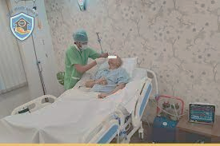
Objectives of Home ICU:
Provide continuous, specialized critical care outside the hospital setting, ensuring patient management and continuous online monitoring.
Enhance patient comfort, quality of life, and safety by reducing the risk of hospital-acquired infections.
Optimize healthcare costs by reducing hospital stays by imparting accessibility to critical care services for critical care patients.

Slide 4
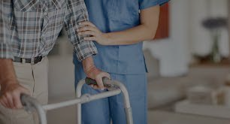
Home Rehabilitation
1. Home rehabilitation enables care in a familiar and comfortable setting, eliminating the need for frequent travel.
2. Personalized attention in a home environment enhances motivation and adherence to treatment plans.
3. Integration into daily routines promotes consistency and long-term engagement in rehabilitation.
4. One-on-one interactions in home rehabilitation foster effective communication and adjustments.
5. Continuous support in a home environment improves satisfaction, functional outcomes and independence.

Slide 5
Doctor Consultation and Electronic Health Records
Integration with electronic health records for comprehensive patient information
Seamless access to Patient management information (ie.,) Medications, Food Intake, Urinary Output, Doctor’s Notes, Physiological and Hematological measurements, Radiology & Pathology Reports.
Access patients through video enabled consultation.
Ability to co-ordinate with team of specialists for patient management on this platform.

Slide 6
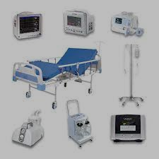
Medjacket
Home ICU equipment
Device integrates with:
  ECG \ SpO2\ NIBP \ Temp \ Blood Glucose\ Hemoglobin.
  Otoscope.
  Drip Flow Meter.
  O2 Flow meter.
  Arterial Blood GAS .
  Ventilator.
  X-Ray
  12 Lead ECG

Slide 7
Continuous Patient Monitoring
Remote Patient Monitoring:
  Real-time monitoring and assessment of patient vital signs, symptoms, and conditions by the care provider from any location.
  Continuous tracking of patient’s physiological parameters (ECG, SpO2, BP, Temperature) and hematological parameters.
Task Assignment and Management:
  Efficient assignment and tracking of tasks, treatments, and medications to nursing staff and other doctors.
  Prioritization and scheduling of tasks to ensure timely delivery of care

Slide 8
Benefits for Doctors and Patients
Reduced risk of infection:- Patients are less likely to contract hospital-acquired infections when they are cared for at home. This is because the home environment is generally cleaner and less crowded than a hospital.
Increased comfort:- Patients are more comfortable at home, surrounded by their loved ones and familiar belongings. This can help to reduce stress and anxiety, which can also contribute to faster recovery.
Lower cost:- Home ICU and rehabilitation is typically much less expensive than hospital care. This is because patients do not have to pay for room and board, and they can often use their own insurance to cover the cost of care.
Improved outcomes:- Patients who are cared for at home typically have better outcomes than those who are cared for in the hospital

Slide 9
Contact Information
Ashok Nagar, bhel, AIE, Ramachandrapuram, Hyderabad, Telangana 502032
Phone number : 90599 73066
Email address : medjacket.in@gmail.com

